Slide 1


University of Mumbai GHARDA INSTITUTE OF TECHNOLOGY Department of Computer Engineering
Academic Year 2022-23
Presented By
Experiment No- 06
46. Sahil Pawar
47. Shouryan Pawar
48. Tejaswini Pawar
49. Sahil Phalke
50. Aman Poskar
51. Yogeshwari Pujari
52. Saloni Raut
53. Shubham Raval
54. Shital Rawool

Slide 2
Implement Bloom Filter using any programming language.

Slide 3
INTRODUCTION
A Bloom filter is a space-efficient probabilistic data structure that is used to test whether an element is a member of a set. For example, checking availability of username is a set membership problem, where the set is the list of all registered user names The price we pay for efficiency is that it is probabilistic in nature that means, there might be some False Positive results. False positive means, it might tell that a given username is already taken but actually it’s not.

Slide 4
Standard Bloom Filter
A Bloom filter is an array of m bits representing a set S = { x 1, x 2, … , x n { } of n elements 1 2 n } o Array set to 0 initially
k independent hash functions h 1, … , h k with range {1 2 } ,, …, m } o Assume that each hash function maps each item in the universe to a random number universe to a random number uniformly uniformly over the range over the range {1, 2, …, m}
For each element x in S, the bit hi(x) in the array i tt 1 f 1 is set to 1, for 1 ≤ i ≤ k, o A bit in the array may be set to 1 multiple times for diff m erent elements

Slide 5
Example
m=5
h1(x) = x mod 5
h2(x) = (2x+3) mod 5
x | h1(x) | h2(x) | B
Insert - 9 | 4 | 1 | 0 1 2 3 4
Insert - 11 | 1 | 0 | 0 1 2 3 4
0 | 1 | 0 | 0 | 1
1 | 1 | 0 | 0 | 1
1 | 1 | 0 | 0 | 1
0 1 2 3 4

Slide 6
1 | 1 | 0 | 0 | 1
0 1 2 3 4
Query:- 15
h1(15) = 0
h2(15) = 3
15 not present
Query:- 16
h1(16) = 1
h2(16) = 0
16 maybe present

Slide 7
Program
def sum(ip):
s=0
for i in ip:
s = int(i)
return s
def h1(ip):
s = sum(ip)
return (s)%5
def h2(ip):
s = sum(ip)
return (2*s+3)%5
bit_vector = [0, 0, 0, 0, 0]
while True:
ip = input("Enter a Integer ")
if(ip == ' '):
break

Slide 8
print("H1",h1(ip),"H2",h2(ip))
bit_vector[h1(ip)]=1
bit_vector[h2(ip)]=1
print(bit_vector)
ip=input("Enter a string to test the membership ")
if(bit_vector[h1(ip)]==1 and bit_vector[h2(ip)]==1):
print(ip,"maybe present")
else:
print(ip,"is not present")

Slide 9
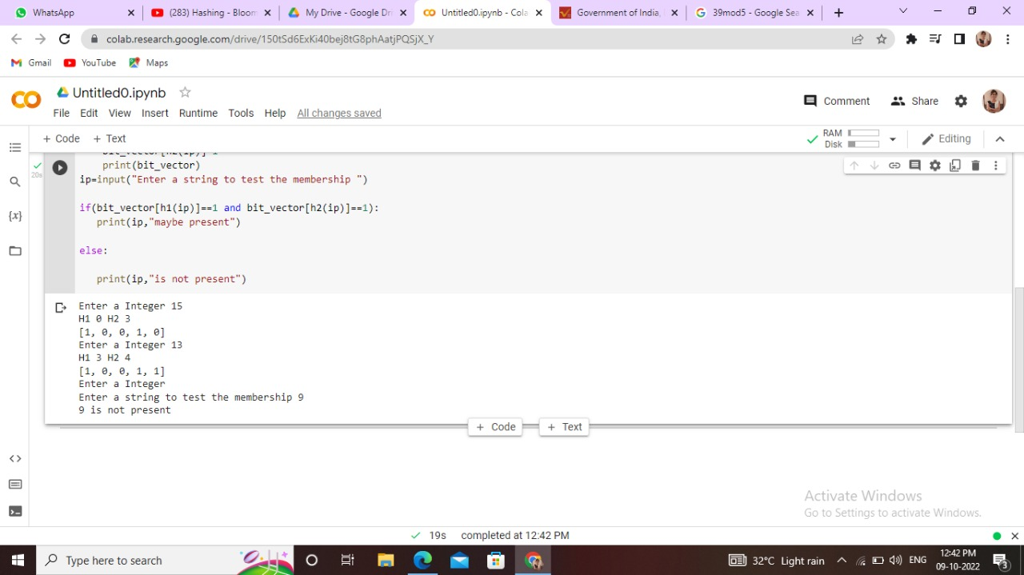
Output:-

Slide 10
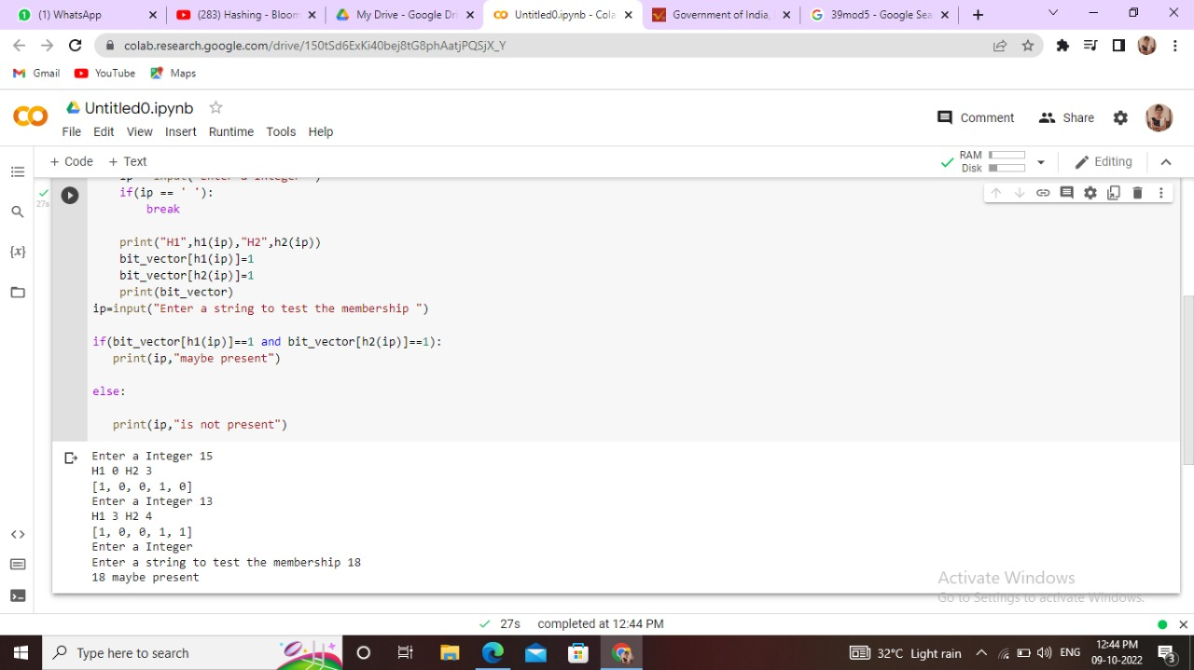

Slide 11
Conclusion
A Bloom filters is like a hash table ,and simply uses one bit to keep track whether an item hashed to the location.
If k=1 , it’s equivalent to a hashing based fingerprint system.
If n=cm for small constant c,such as c=8 ,then k=5 or 6 ,the false positive probability is just over 2% .
It’s interesting that when k is optimal
k=ln(2)*(n/m) , then p= 1/2.
An optimized Bloom filters looks like a random bit-string

